Slide 1

Navigating the Skies
Crafting a Data-Driven Entry Strategy for India's Aviation Sector
Notes:
Welcome, everyone, …..to our presentation on Navigating the Skies: for Crafting a…Data-Driven .. Entry Strategy….for India's Aviation Sector.
Let me introduce my team .

Slide 2







tEam
Pooja kannuri
Sai Mona Duvvapu
Akshita Sharma
Sathwik Kanukuntla
Rahul Kunku
ArAvind Teja
Notes:
----let me introduce my team.
I am Akshita, and we have Rahul to walk us through dataset and normalization process
Then Mona will explain the ERD and Relational data model ,
Post which Pooja and Sathwik will walk us through our analysis and SQL queries.
Finally, Aravind will shed some light on highlights of our project and key learnings.
Now lets see the problem we are trying to tackle

Slide 3



Business Problem
Despite the immense potential in the Indian aviation sector, establishing a new airline faces the challenge of setting an optimal entry price point amidst fierce competition.
The absence of a data-driven pricing strategy hinders effective market penetration and sustainable growth.
New Entrant Challenges
Market
Dynamics
Competitive
Landscape
Profitability
Challenges
Notes:
----Now lets see the problem we are trying to tackle
Emergent airlines aiming to enter the Indian aviation sector encounter formidable challenges. Chief among these hurdles is the daunting level of competition posed by established players such as Air Asia, Alliance Air, and Go First. Additionally, the diverse array of traveler profiles …… presents a complex landscape for new entrants.
Furthermore, the volatility inherent in market dynamics, including fluctuating …demand….. And….. pricing, adds another layer of complexity.
Strategic market entry becomes imperative due to limited resources,….. requiring meticulous route selection,…. itinerary planning, ……and airport location decisions. To tackle these challenges , emergent airlines must adopt a data-driven approach,….. utilizing comprehensive data sources to finalize crucial decisions regarding…… pricing strategies, …..route planning, ….and operational tactics.
So to tackle this …

Slide 4




Objective
To address this, our objective is to develop comprehensive pricing recommendation utilizing advanced SQL analytics.
We aim to devise a versatile pricing framework tailored to diverse traveler profiles and journey patterns.
Flight Data
Itinerary Data
Airport Data
Demographic
Data
This initiative seeks to equip the new airline with a competitive advantage during its market introduction.
Notes:
---So to tackle this
We aim to devise …..a versatile pricing framework….. tailored to diverse traveler profiles …..and journey patterns.
To address this, our objective is to develop comprehensive pricing recommendation utilizing advanced SQL.
By leveraging detailed …..flight, itinerary, and airport data ….from a leading Indian travel app,……. augmented with demographic variables , This initiative seeks to equip the new airline with….. a competitive advantage….. during its market introduction.
Now I will hand over to Rahul , to walk us through the data set

Slide 5

Data Set
Airlines
Number of Records | 1,405
Number of Columns | 2
Flights Booking & Fares
Number of Records | 452,088
Number of Columns | 13
Data Cleaning
Feature Selection
Normalization
Airports
Number of Records | 41
Number of Columns | 11
Airports in India
Number of Records | 344
Number of Columns | 20
Place
Number of Records | 493
Number of Columns | 10
Indian Cities Demographics
Number of Records | 493
Number of Columns | 22
Travel_Info
Number of Records | 10,106
Number of Columns | 12

Slide 6
Normalization Process
0 NF Form
3 NF Form

Slide 7
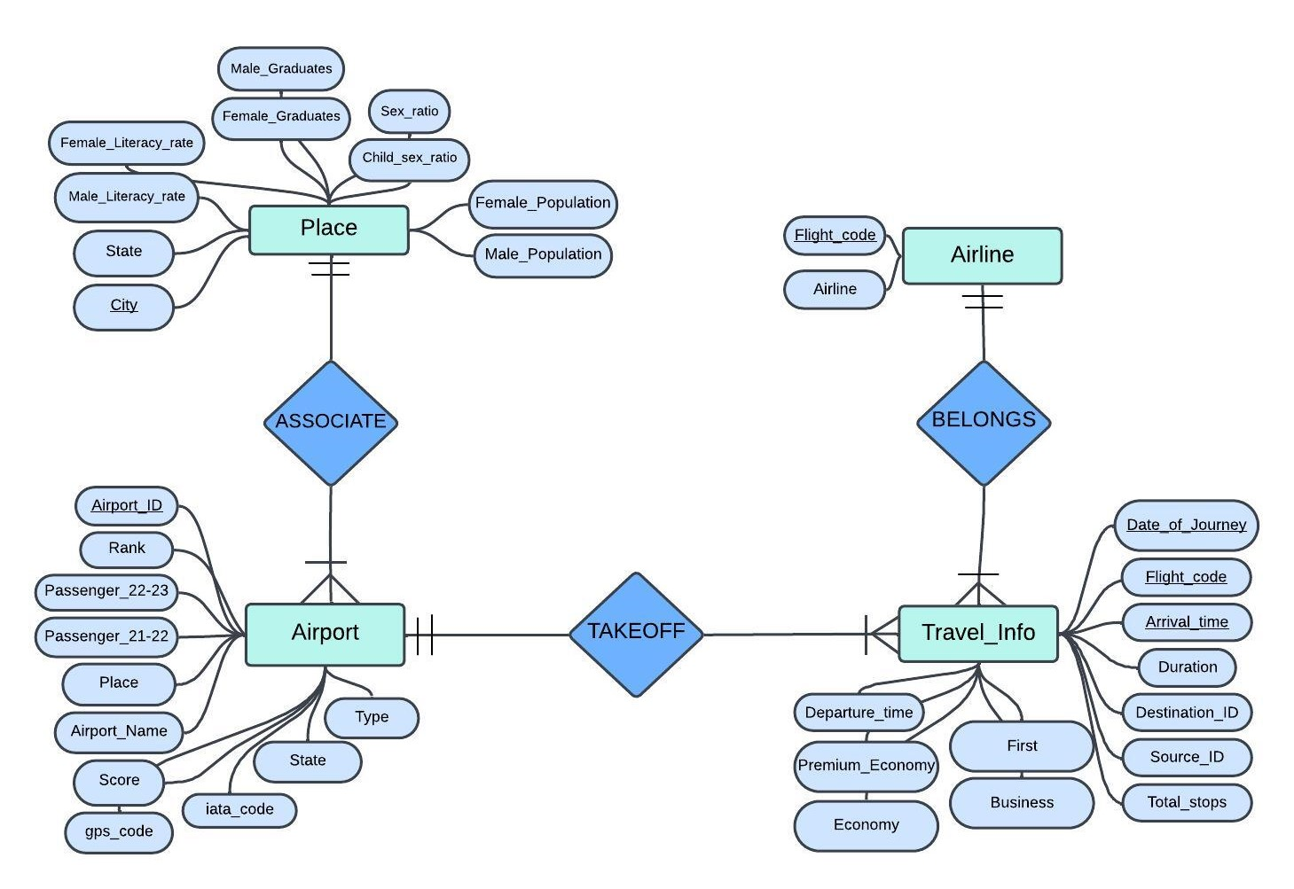
Entity Relationship Diagram

Slide 8
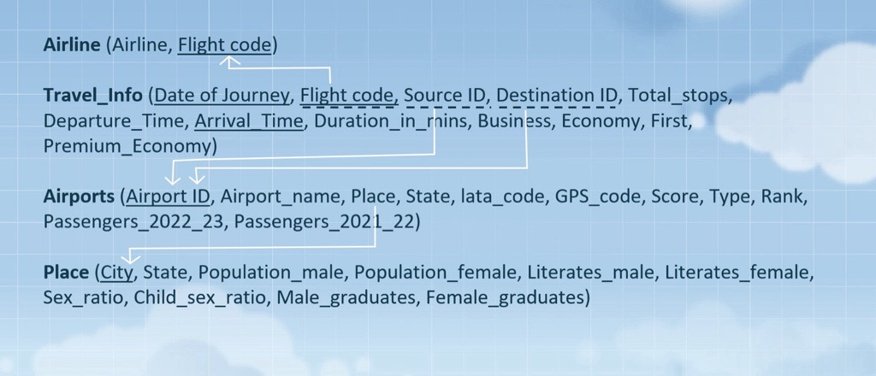
Relational Data Model

Slide 9
Queries and use cases

Slide 10


Economy class Pricing analysis
01
DELIMITER &&
CREATE PROCEDURE GetAvgEconomyPrice (IN Flight_Code VARCHAR(10), IN Source_ID INT)
BEGIN
SELECT a.Airline AS Airline_Name, ap.Airport_name AS Source_Airport_Name, ap.Place AS Source_Place_Name, AVG(ti.Economy) AS Average_Economy_Price
FROM travel_info ti
INNER JOIN airlines a ON ti.Flight_code = a.Flight_code INNER JOIN airports ap ON ti.Source_ID = ap.Airport_ID
WHERE ti.Flight_code = Flight_Code AND ti.Source_ID = Source_ID
GROUP BY a.Airline, ap.Airport_name, ap.Place;
END && DELIMITER ;
CALL GetAvgEconomyPrice('9I-894', 26618);
To determine the average price of economy class tickets for a specific competitor airline, broken down by source location

Slide 11
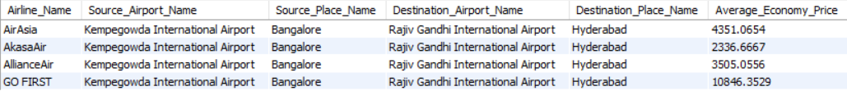
Competitor fare analysis for different locations
02
DELIMITER &&
CREATE PROCEDURE GetAirlinesWithPlacesAveragePrice(IN Source_ID INT, IN Destination_ID INT)
BEGIN SELECT a.Airline AS Airline_Name, src_ap.Airport_name AS Source_Airport_Name, src_ap.Place AS Source_Place_Name, dest_ap.Airport_name AS Destination_Airport_Name, dest_ap.Place AS Destination_Place_Name, AVG(ti.Economy) AS Average_Economy_Price
FROM travel_info ti
INNER JOIN airlines a ON ti.Flight_code = a.Flight_code
INNER JOIN airports src_ap ON ti.Source_ID = src_ap.Airport_ID
INNER JOIN airports dest_ap ON ti.Destination_ID = dest_ap.Airport_ID
WHERE ti.Source_ID = Source_ID AND ti.Destination_ID = Destination_ID
GROUP BY a.Airline, src_ap.Airport_name, src_ap.Place, dest_ap.Airport_name, dest_ap.Place;
END && DELIMITER ;
CALL GetAirlinesWithPlacesAveragePrice('35145', '35141');
To analyze and compare the average ticket prices of competitive airlines based on various factors: source place, source airport, destination place, and destination airport

Slide 12
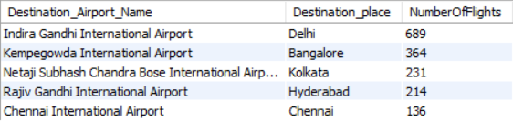
Popular Destinations from Source Airport
03
DELIMITER &&
CREATE PROCEDURE TopDestinationFromSource(IN SourceAirportID INT)
BEGIN
SELECT dest_ap.Airport_name AS Destination_Airport_Name, dest_ap.Place AS Destination_place,
COUNT(ti.Flight_code) AS NumberOfFlights
FROM travel_info ti
INNER JOIN airports dest_ap ON ti.Destination_ID = dest_ap.Airport_ID
WHERE ti.Source_ID = SourceAirportID
GROUP BY ti.Destination_ID, dest_ap.Airport_name, dest_ap.Place
ORDER BY NumberOfFlights DESC
LIMIT 5;
END && DELIMITER ;
CALL TopDestinationFromSource('26434');
To identify and rank the top five most popular destination airports based on the number of flights departing for each

Slide 13
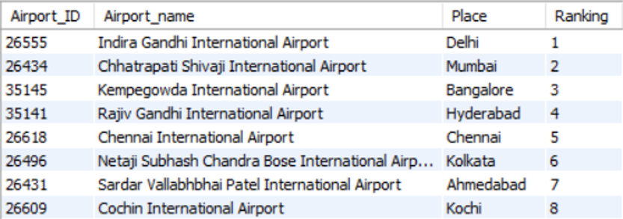
Airport Rank Hierarchical Structure
04
WITH RECURSIVE AirportHierarchy AS
(
SELECT Airport_ID, Airport_name, Place, Ranking
FROM airports
WHERE Ranking = (SELECT MIN(Ranking) FROM airports)
UNION ALL
SELECT a.Airport_ID, a.Airport_name, a.Place, a.Ranking
FROM airports a
INNER JOIN AirportHierarchy ah
ON a.Ranking = ah.Ranking + 1
)
SELECT * FROM AirportHierarchy limit 8;
To establish a hierarchy of airports based on their popularity

Slide 14
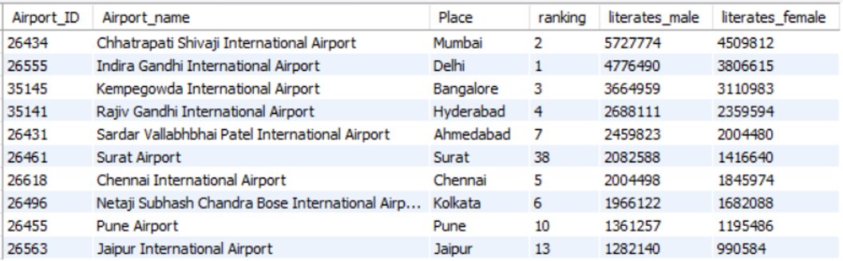
Airport Ranking Based on Literacy Rates
05
SELECT a.Airport_ID, a.Airport_name, a.Place, a.ranking,
(SELECT b.literates_male FROM place b WHERE a.Place = b.city) AS literates_male,
(SELECT b.literates_female FROM place b WHERE a.Place = b.city) AS literates_female
FROM airports a
ORDER BY literates_male DESC, literates_female DESC
LIMIT 10;
To identify and rank the top 10 airports based on the literacy rates of males and females in their respective locations

Slide 15
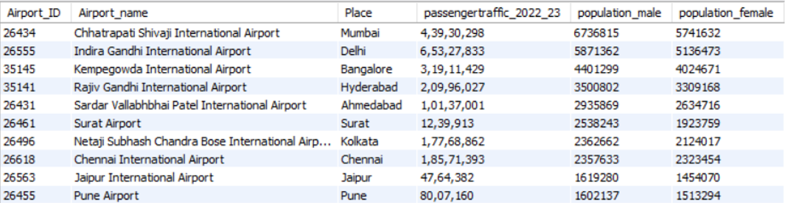
Airport Traffic analysis
06
SELECT
a.Airport_ID, a.Airport_name, a.Place, a.Passengers_2022_23 as passengertraffic_2022_23,
(SELECT b.population_male FROM place b WHERE a.Place = b.city) AS population_male,
(SELECT b.population_female FROM place b WHERE a.Place = b.city) AS population_female
FROM airports a
ORDER BY population_male DESC, population_female DESC
LIMIT 10;
To ascertain and rank the top 10 airports based on their passenger traffic

Slide 16
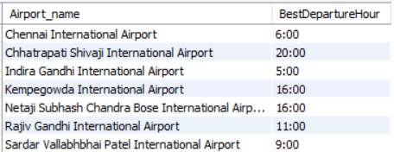
Analysis of Airport Peak Departure Times
07
WITH DepartureArrivalTimes AS
(SELECT a.Airport_name, EXTRACT(HOUR FROM t.Departure_Time) AS DepartureHour,
COUNT(*) OVER (PARTITION BY a.Airport_ID, EXTRACT(HOUR FROM t.Departure_Time)) AS DepartureCount, COUNT(*) OVER (PARTITION BY a.Airport_ID, EXTRACT(HOUR FROM t.Arrival_Time)) AS ArrivalCount
FROM travel_info t
JOIN Airports a ON t.Source_ID = a.Airport_ID OR t.Destination_ID = a.Airport_ID ),
RankedDepartureTimes AS
(SELECT Airport_name, DepartureHour, DepartureCount,
RANK() OVER (PARTITION BY Airport_name ORDER BY DepartureCount DESC) AS DepartureRank
FROM DepartureArrivalTimes )
SELECT DISTINCT d.Airport_name, CONCAT(d.DepartureHour,":00") AS BestDepartureHour
FROM RankedDepartureTimes d
WHERE d.DepartureRank = 1
ORDER BY d.Airport_name;
To identify the busiest departure times at various airports

Slide 17
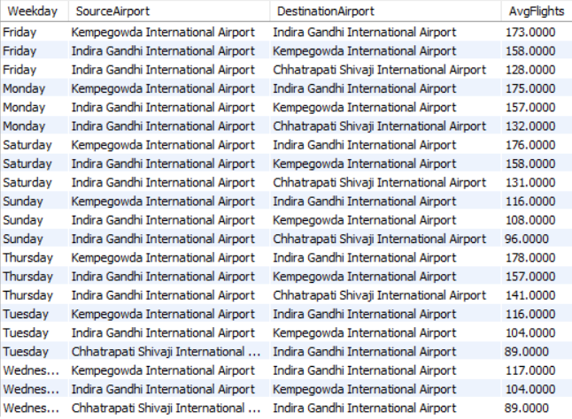
Weekday Flight Frequency Analysis
08
WITH DailyFlights AS
(SELECT DAYNAME(STR_TO_DATE(t.Date_of_journey, '%d-%m-%Y')) AS Weekday, s.Airport_name AS SourceAirport, d.Airport_name AS DestinationAirport, COUNT(*) AS FlightsOnDay
FROM travel_info t
JOIN airports s ON t.Source_ID = s.Airport_ID
JOIN airports d ON t.Destination_ID = d.Airport_ID
GROUP BY Weekday, SourceAirport, DestinationAirport),
RankedFlights AS ( SELECT Weekday, SourceAirport, DestinationAirport, AVG(FlightsOnDay) AS AvgFlights,
RANK() OVER (PARTITION BY Weekday ORDER BY AVG(FlightsOnDay) DESC) AS Day_Rank
FROM DailyFlights
GROUP BY Weekday, SourceAirport, DestinationAirport)
SELECT Weekday, SourceAirport, DestinationAirport, AvgFlights
FROM RankedFlights WHERE Day_Rank <= 3
ORDER BY Weekday, Day_Rank;
To determine the average number of flights operating from a specific source to a destination airport on a given weekday

Slide 18
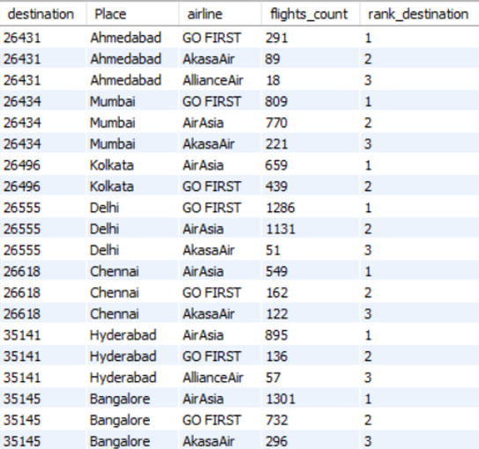
Popularity Ranking of Airlines by Destination
09
WITH FlightCounts AS (
SELECT a.Airline AS airline, ti.destination_id AS destination, ap.Place, COUNT(*) AS flights_count
FROM travel_Info ti
JOIN airlines a ON ti.flight_code = a.flight_code
JOIN airports ap ON ap.airport_ID = ti.destination_id
GROUP BY a.Airline, ti.destination_id, ap.Place),
RankedAirlines AS
(SELECT airline, destination, Place, flights_count,
RANK() OVER(PARTITION BY destination ORDER BY flights_count DESC) AS rank_destination
FROM FlightCounts)
SELECT destination, Place, airline, flights_count, rank_destination
FROM RankedAirlines
WHERE rank_destination <= 3;
To rank airlines based on their popularity for specific destinations

Slide 19
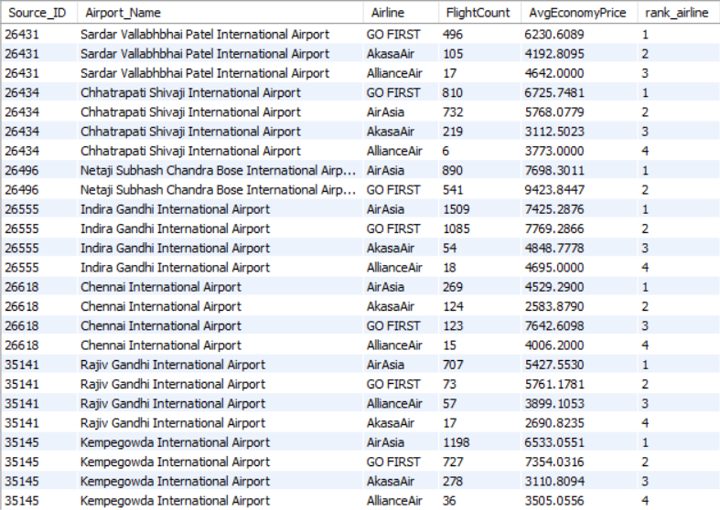
POPULAR Airlines Based on Flight Freq. from a Source
10
WITH AirlineFlightCounts AS
(SELECT ti.Source_ID, a.Airline, COUNT(ti.Flight_code) AS FlightCount, AVG(ti.Economy) AS AvgEconomyPrice
FROM travel_info ti
JOIN airlines a ON ti.Flight_code = a.Flight_code
GROUP BY ti.Source_ID, a.Airline),
RankedAirlines AS
(SELECT Source_ID, Airline, FlightCount, AvgEconomyPrice, RANK() OVER (PARTITION BY Source_ID ORDER BY FlightCount DESC) AS rank_airline
FROM AirlineFlightCounts)
SELECT ra.Source_ID, ap.Airport_name AS Airport_Name, ra.Airline, ra.FlightCount, ra.AvgEconomyPrice, ra.rank_airline
FROM RankedAirlines ra
JOIN airports ap ON ra.Source_ID = ap.Airport_ID
ORDER BY ra.Source_ID, ra.rank_airline;
To rank airlines based on the average number of flights they operate from a given source airport

Slide 20
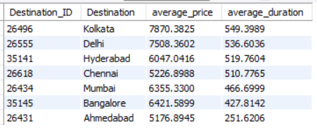
Flight Duration and Pricing Correlation Analysis
11
CREATE VIEW DurationPricing AS
SELECT
ti.destination_ID,
AVG(ti.economy) AS average_price, AVG(duration_in_mins) AS average_duration
FROM travel_Info ti
GROUP BY ti.destination_ID;
SELECT
dp.destination_ID AS Destination_ID,
ap.place AS Destination,
dp.average_price,
dp.average_duration
FROM DurationPricing dp
JOIN airports ap ON ap.airport_ID = dp.destination_id
ORDER BY average_duration DESC;
To examine the relationship between flight duration and ticket pricing across different airlines

Slide 21
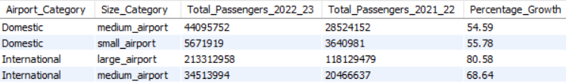
Analysis of Traffic by Airport Category and Size
12
SELECT
CASE
WHEN Airport_name REGEXP '[Ii]nternational’
THEN 'International’
ELSE 'Domestic’
END AS Airport_Category, type AS Size_Category,
SUM(Passengers_2022_23) AS Total_Passengers_2022_23, SUM(Passengers_2021_22) AS Total_Passengers_2021_22
FROM airports
GROUP BY Airport_Category, Size_Category
ORDER BY Airport_Category, Size_Category;
To evaluate the scalability of airports by analyzing passenger counts for domestic and international flights in relation to airport size.

Slide 22
Summary of sql techniques UTILIZED
Advanced Joins
Aggregations
Subqueries
Partition
Window Functions
CTEs
Recursive CTEs
Time Functions
Case When
REGEXP

Slide 23
Key Takeaways
Utilized advanced SQL analytics to process comprehensive flight itinerary and airport data, augmented by demographic insights
Devised a strategic entry price point for a new airline in the Indian aviation sector
Delivered a multifaceted pricing framework, route analysis, and airport ranking based on various parameters for informed decision-making

Slide 24



Challenges along the way
Data Preprocessing
SQL Limitations
Market Dynamics
Ensuring data cleanliness and relevance from diverse sources for accurate analysis
Managing complex queries and optimizing performance for large datasets
Navigating highly competitive and price-sensitive Indian aviation sector

Slide 25
Learnings
Importance of data integrity and the impact of data quality on analytical outcomes
Advanced SQL techniques (e.g., CTEs, window functions, aggregations) for deep market insights
The significance of understanding market dynamics and consumer behavior in pricing strategies
Role of data-driven decision-making in establishing competitive advantages in challenging markets

Slide 26
THANK YOU!

Slide 27
Database Implementation
APPENDIX
We imported our Excel-based research database into MySQL using the Import Data Wizard:
Access the wizard in MySQL Workbench under the "Server" menu > "Data Import" > "Import from Self-Contained File.”
Select the Excel file from the Airlines directory.
Specify the target schema and database or create new ones.
Map columns and configure options like data type alignment.
Begin the data import process.

